Slide 1

Differentiated cancer of thyroid
-Dr Shivam Pandya

Slide 2
Solitary thyroid nodule
A thyroid nodule is a discrete lesion within thyroid gland distinct from surrounding thyroid parenchyma.
Nodule >1 cm should be evaluated further.
Nodule <1 cm can be evaluated, if associated with neck nodes, voice changes, pain etc.

Slide 3
Evaluation of Solitary thyroid nodules
Thyroid nodule
TSH
Thyroglobulin
FDG PET
Insensitive and non specific test for thyroid cancer
Focal FDG PET uptake in a sonographically confirmed thyroid nodule confers increased risk of thyroid cancer
TSH raised
TSH subnormal
Radioiodine scan to look for activity (hot/warm/cold)
No scan required. Indicates high risk of malignancy
FNAC recommended for lesions >1 cm
Diffuse uptake, along with sonographic and clinical evidence of chronic lymphocytic thyroiditis does not reqquire further imaging or FNAC.

Slide 4
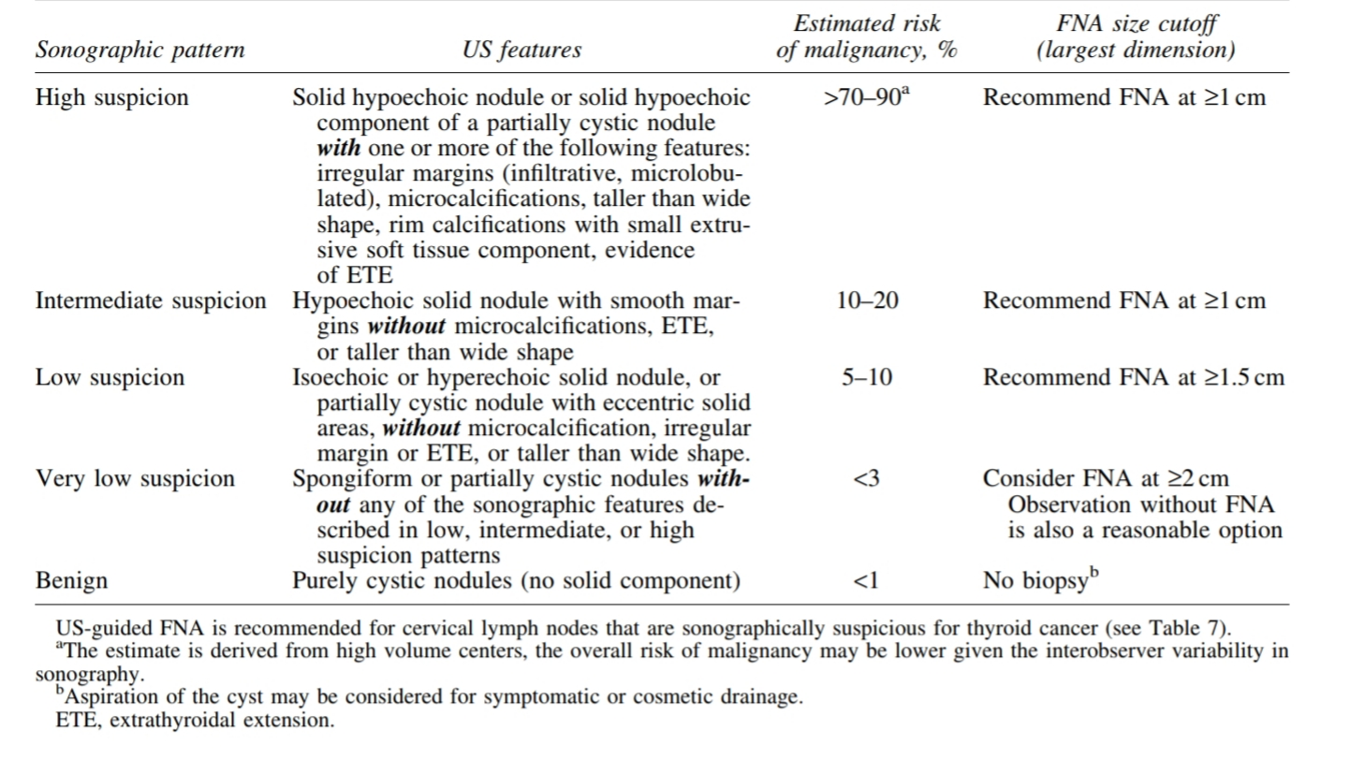
Thyroid USG and FNAC
ATA recommendation- Thyroid USG with survey of cervical nodes should be performed in all patients with known or suspected thyroid nodules.

Slide 5
Thyroid FNAC
Criteria for adequacy of specimen- Presence of atleast six groups of well-visualized follicular cells, each group having atleast 10 well preserved epithelial cells, preferably on a single slide.
FNAC classification systems:-
1) Bethesda
2) BTA/RCP/RCPath
The ATA guidelines follow Bethesda guidelines.

Slide 6
Bethesda
Nondiagnostic or unsatisfactory (1-4%)
Benign (0-3%)
BTA
Thy 1- Inadequate
Thy 2- Benign
AUS/FLUS (5-15%)
Follicular neoplasm or suspicious for a follicular neoplasm (15-30%)
Suspicious for malignancy (60-75%)
Malignant (97-99%)
Thy 3- Suspiscious or neoplasm
Thy 4- Suspicious for malignancy
Thy 5- Malignant

Slide 7
Management of thyroid nodule as per cytology report
Non diagnostic- Repeat FNAC- waiting period of 3 months from previous FNAC. Maybe done sooner if USG is highly suspicious.
Benign- Observe
AUS/FLUS- Cells with architectural and/or nuclear atypia more pronounced than for benign, but not sufficient enough to be called malignant- second opinion at a high volume centre/repeat cytology/Molecular testing (BRAF, RET-PTC, PAX8/PPAR-gamma)---→ If still inconcluive, or not performed, either surveillance or diagnostic surgical excision can be done based on patient preferences and risk factors.
(contd.)

Slide 8
Follicular neoplasm- Cellular aspirates comprised of follicular cells arranged in an altered architectural pattern characterized by cell-crowding and/or microfollicle formation lacking nuclear features of PCT, or comprised almost exclusively of Oncocytic cells. Diagnostic surgical excision is long-standing standard of care, but may be supplemented by molecular testing (seven gene panel, including BRAF, RET-PTC, PAX8/PPAR gamma). If molecular testing not done---→ Surgery.
Suspicious for papillary carcinoma- Surgical management, similar to malignant cytology, depending on clinical risk factors, sonographic features, patient preference and possibly, results of mutational testing.
Malignant- Surgery

Slide 9
Surgery for cytologically indeterminate thyroid nodules
Thyroid lobectomy is the recommended initial surgical approach for cytologically indeterminate solitary nodule
Total thyroidectomy may be preferred in
-patients with indeterminate nodules cytologically suspicious for malignancy
positive for known mutations specific for carcinoma
sonographically suspicious
> 4cm size
in patients with familial thyroid carcinoma
childhood history of radiation exposure.

Slide 10
Nodules with high suspicion USG pattern
Repeat USG guided FNA within 12 months
Nodules with low to intermediate suspicion USG
Songraphic evidence of growth (20% increase in two nodule dimension, with a minimal increase of 2 mm or >50% change in volume and/or new lesion
USG guided FNAC- benign
Repeat USG+FNAC
Nodules with very low suspicion USG pattern
Repeat USG after >24 months
If benign on repeat FNAC, USG surveillance no longer indicated

Slide 11
Follow up for nodules that do not meet FNA criteria
High suspicion USG pattern
Repeat USG in 6-12 months
Low to intermediate suspicion USG
Repeat USG at 12-24 months
Nodules > 1cm with very low suspicion USG pattern and pure cyst
Repeat USG after 24 months
Nodules < 1cm with very low suspicion USG pattern
No need for sonographic follow up

Slide 12
Pathology of thyroid malignancies
Follicular adenoma –Solitary, benign encapsulated tumor which shows follicular epithelial differentiation with no evidence of either capsular or vascular invasion and neither architectural nor cytological features of PCT.
Follicular adenoma + squamous metaplasia = Papillary thyroid carcinoma, follicular variant (FVPTC)
Follicular tumor of uncertain malignant potential (FTUMP)- Follicular neoplasms, which display some worrisome microscopic features, but not unequivocal capsular or vascular infiltration.

Slide 13
2) Follicular carcinoma thyroid- 5-15% of all thyroid cancers.
Cytology shows follicular cell differentiation, bereft of features of PCT.
Categories of FCT
Minimally invasive follicular ca (MIFC)
More common
Widely invasive follicular ca (WIFC)
Infiltrative, destructive, multinodular growth
Microscopic transcapsular invasion
Pericapsular vascular infiltration
Angioinvasion in FCT is defined as polypoidal intraluminal growth either endothelialized
with or without thrombus, although not necesarrily adherent.

Slide 14
Papillary ca thyroid- Histopathological features are as under
Focal nuclear enlargement (nucleomegaly)
Nuclear crowding and nuclear overlap (basket of eggs)
Homogenization of karyoplasm (ground glass)
Margination of chromatin (Orphan Annie eye)
Longitudinal nuclear grooves (coffee bean nucleus)
Redundant folded nuclear membrane and intranuclear cytoplasmic inclusions (pseudoinclusions)
Laminated calcospherites (Psammoma bodies)

Slide 15
Histological variants of PCT
- Tall cell
- Diffuse sclerosing
- Diffuse follicular
Solid
Trabecular
Dedifferentiated
Oncocytic
Clear cell
Cribriform morular
Spindle cell
Lipomatous stroma
Macrofollicular

Slide 16
Papillary thyroid microcarcinoma
<10 mm diameter
Often an incidental finding in thyroid lobes removed for non malignant reasons
Minute- <5 mm, Tiny- 5-10 mm
Indolent clinical course, excellent prognosis
High risk lesions- 2 or more foci, LVI, ETE, high risk morpho
The term is restricted for those >19 years of age, as under that age, subcentimetric papillary ca often have ETE.

Slide 17
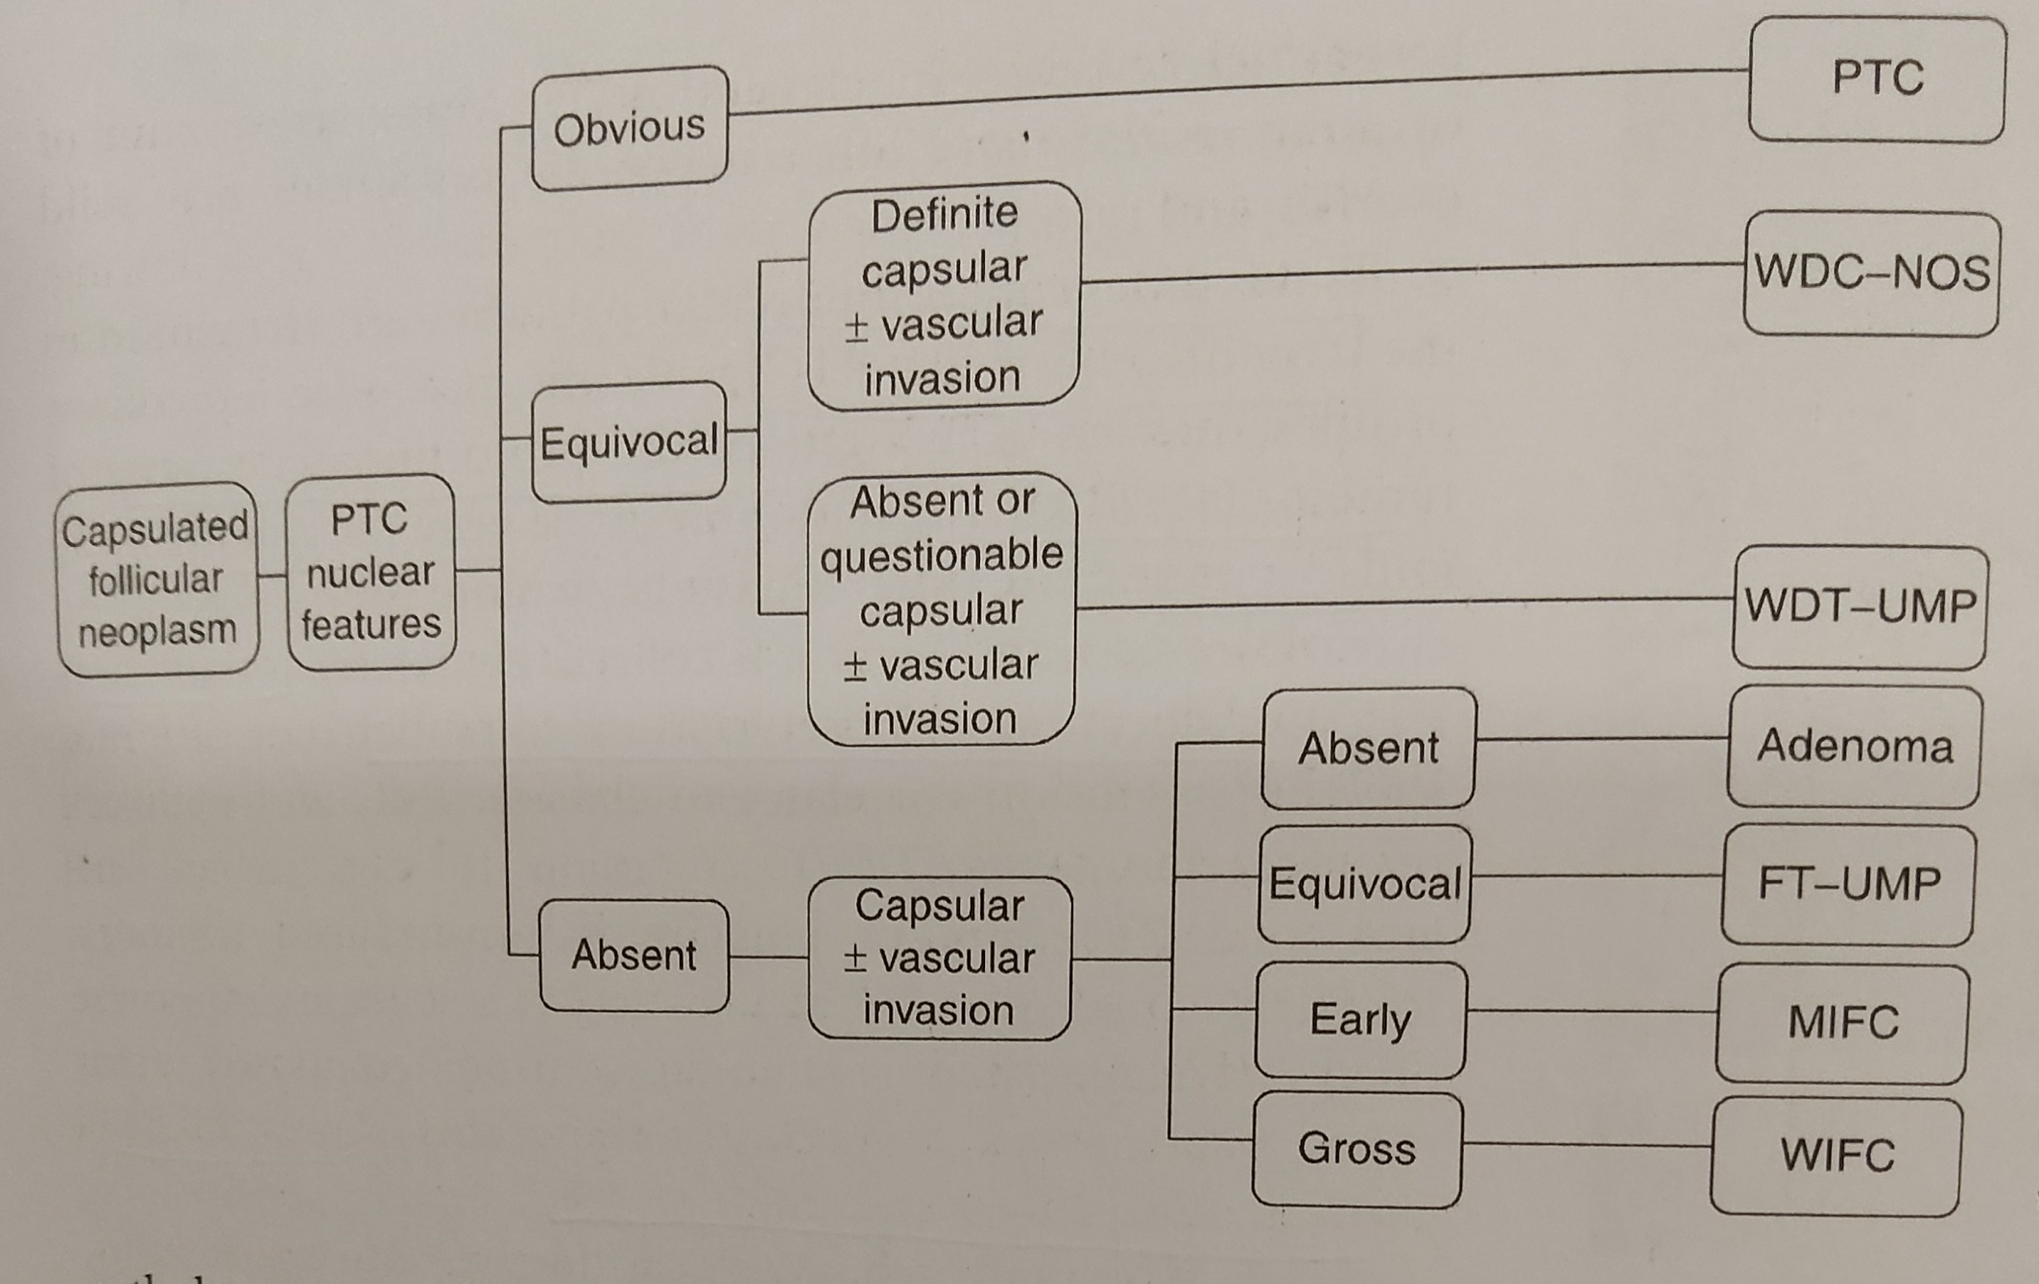

Slide 18
Genetic syndromes assoicated with Ca thyroid
Papillary thyroid carcinoma with papillary renal neoplasia- 1q21
Familial nonmedullary thyroid carcinoma- 2q21 and 19p13
Familial thyroid tumors with cell oxyphilia- 19p13.2
Familial adenomatous polyposis 5q21/22
Cowden disease- 10q23.3/PTEN
Carney complex 1- 17q/PRKAR1A

Slide 19
Genes associated with Ca thyroid
RET/PTC- Proto-oncogene, located at 10q11.2- PTC
RAS- Ras activation stimulates mitosis and reduced diferentiation. More common in follicular variant of PTC.
TRK- oncogene located at chr 1q22. Mutated in 10-25% PCT
B-RAF- Demonstrated in 40-70% of PTC, associated with poor clinical outcome
PAX8/PPAR gamma- Commonly seen in follicular carcinomas compared to adenomas. Tumors positive for this gene are likely to be widely invasive.

Slide 20
Prognostic scoring systems- AGES (Age, Grade, Tumor extent, Size)
Prognostic score = 0.05 x age (if age >/= 40)
+ 1 (if grade 2)
+ 3 (if grade 3 or 4)
+ 1 (if extrathyroid)
+ 3 (if distant spread)
+ 0.2 x tumor size (cm maximum diameter)
Survival by AGES score (20-yr):
=/< 3.99 = 99%
4-4.99 = 80%
5-5.99 = 67%
>/= 6 = 13%

Slide 21
Prognostic scoring systems- AMES (Age, Metastatic disease, Extrathyroid extension, Size)
Low risk:
Younger patients (men =/< 40, women =/< 50)
with no metastases
Older patients (intrathyroid papillary, minor
capsular invasion for follicular lesions)
Primary cancers <5 cm
No distant metastases
High risk:
All patients with distant metastases
Extrathyroid papillary, major capsular
invasion follicular
Primary cancers >/= 5 cm in older patients
(men >40, women >50)
Survival by AMES risk-groups (20-yr):
Low risk = 99%
High risk = 61%

Slide 22
Prognostic scoring systems- MACIS (Metastasis, Age, Completeness of resection, Local Invasion, Tumor Size)
Score = 3.1 (if age <40 years) or 0.08 x age (if age >/= 40 yrs)
+ 0.3 x tumor size (cm maximum diameter)
+ 1 (if incompletely resected)
+ 1 (if locally invasive)
+ 3 (if distant spread)
Survival by MACIS score (20-yr):
< 6 = 99%
6-6.99 = 89%
7-7.99 = 56%
>/= 8 = 24%

Slide 23
Prognostic scoring systems- TNM staging
Primary tumor (pT) for papillary, follicular, poorly differentiated, Hürthle cell and anaplastic thyroid carcinomas:TX: Primary tumor cannot be assessed
T0: No evidence of primary tumor
T1: Tumor ≤ 2 cm in greatest dimension limited to the thyroid
  T1a: Tumor ≤ 1 cm in greatest dimension limited to the thyroid
  T1b: Tumor > 1 cm but ≤ 2 cm in greatest dimension limited to the thyroid
T2: Tumor > 2 cm but ≤ 4 cm in greatest dimension limited to the thyroid
T3*: Tumor > 4 cm limited to the thyroid or gross extrathyroidal extension invading only strap muscles
  T3a*: Tumor > 4 cm limited to the thyroid
  T3b*: Gross extrathyroidal extension invading only strap muscles (sternohyoid, sternothyroid, thyrohyoid or omohyoid muscles) from a tumor of any size
T4: Includes gross extrathyroidal extension into major neck structures
  T4a: Gross extrathyroidal extension invading subcutaneous soft tissues, larynx, trachea, esophagus or recurrent laryngeal nerve from a tumor of any size
  T4b: Gross extrathyroidal extension invading prevertebral fascia or encasing carotid artery or mediastinal vessels from a tumor of any size
Regional lymph node (pN):NX: Regional lymph nodes cannot be assessed
N0: No evidence of regional lymph node metastasis
  N0a*: One or more cytologic or histologically confirmed benign lymph nodes
  N0b*: No radiologic or clinical evidence of locoregional lymph node metastasis
N1*: Metastasis to regional nodes
  N1a*: Metastasis to level VI or VII (pretracheal, paratracheal, prelaryngeal / Delphian or upper mediastinal) lymph nodes; this can be unilateral or bilateral disease
  N1b*: Metastasis to unilateral, bilateral or contralateral lateral neck lymph nodes (levels I, II, III, IV or V) or retropharyngeal lymph nodes
Distant metastasis (M):M0: No distant metastasis
M1: Distant metastasis

Slide 24
Age at diagnosis < 55 years
Stage I:any T any N M0
Stage II:any T any N M1
Age at diagnosis ≥ 55 years
Stage I:T1 N0 / NX M0, T2 N0 / NX M0
Stage II:T1N1M0 T2N1M0 T3a / T3b any N M0
Stage III:T4a any NM0
Stage IVA:T4b any NM0
Stage IVB:any T any NM1

Slide 25
Management of Differentiated ca thyroid
PRE-OPERATIVE
Pre op USG for cervical lymph nodes + FNAC from suspicious lymph nodes
Sonographic features of malignant nodes- enlargement, loss of fatty hilum, rounded shape, hyperechogenicity, cystic change, calcifications, peripheral vascularity.
2) Pre- op CT/MRI with IV contrast should be done in advanced disease, bulky tumor or multiple neck nodes. FDG PET is NOT recommended.
3) Routine pre-op Tg level is not recommended

Slide 26
OPERATIVE APPROACH
Size > 4 cm
Gross ETE
Clinicial N1
M1
Near total or total thyroidectomy
Size 1-4 cm
Without ETE
cN0
M0
Near total/total thyroidectomy, or lobectomy if low risk PCT/FCT
If size <1 cm, no ETE, N0---→ Thyroid lobectomy

Slide 27
Lymph nodes
Clinically involved central nodes
Therapeutic central compartment node dissection
cN0 with T3/T4 or clinically involved lateral neck nodes
Prophylactic CCND
T1, T2, noninvasive, cN0
Neck dissection not needed
Biopsy proven metastatic lateral cervical lymphadenopathy
Therapeutic lateral neck dissection

Slide 28
Completion thyroidectomy
Should be offered to the patient for whom bilateral thyroidectomy would have been recommended had the diagnosis been available before surgery.

Slide 29
Post operative
TNM and MACIS systems provide the most accurate post operative staging information.
ATA Initial Risk Stratification System is recommended for DTC patients treated with thyroidectomy to predict recurrence
Low risk | Intrathyroidal DTC, </= 5 LN micromets (<0.2 cm)
Intermediate risk | Aggressive histology, minor extrathyroidal extension, vascular invasion or > 5 LN (0.2-3 cm)
High risk | Gross ETE, incomplete tumor resection, distant mets, LN > 3 cm

Slide 30
Impact of BRAF-V600E and other mutations in risk estimates- BRAF mutations are associated with increased disease specific mortality, lymph node mets and increased risk of recurrence.
Other markers- p53, TERT

Slide 31
Post op Serum Tg
Serum Tg and thyroglobulin antibodies should be measured together, ideally in the same laboratory, in the same assay.
During initial follow up, serum Tg should be measured every 6-12 months. The interval may be lengthened to 12-24 months later in low to intermediate risk patients.
Should be calibrated against CRM-457 standard.
They are measured after either withdrawal of thyroxine therapy or by rhTSH injections. A single rhTSH stimulated Tg <0.5-1ng/ml in the absence of antiTg antibodies has 98-99.5% chance of identifying tumor free status.

Slide 32
Response to therapy
Excellent response- No clinical, biochemical or structural evidence of disease
Biochemical incomplete response- abnormal Tg or rising anti-Tg antibody levels in the absence of localizable disease
Structural incomplete response- Persistent or newly identified loco regional or distant mets
Indeterminate- non specific biochemical or structural findings that canno be classified as benign or malignant.

Slide 33
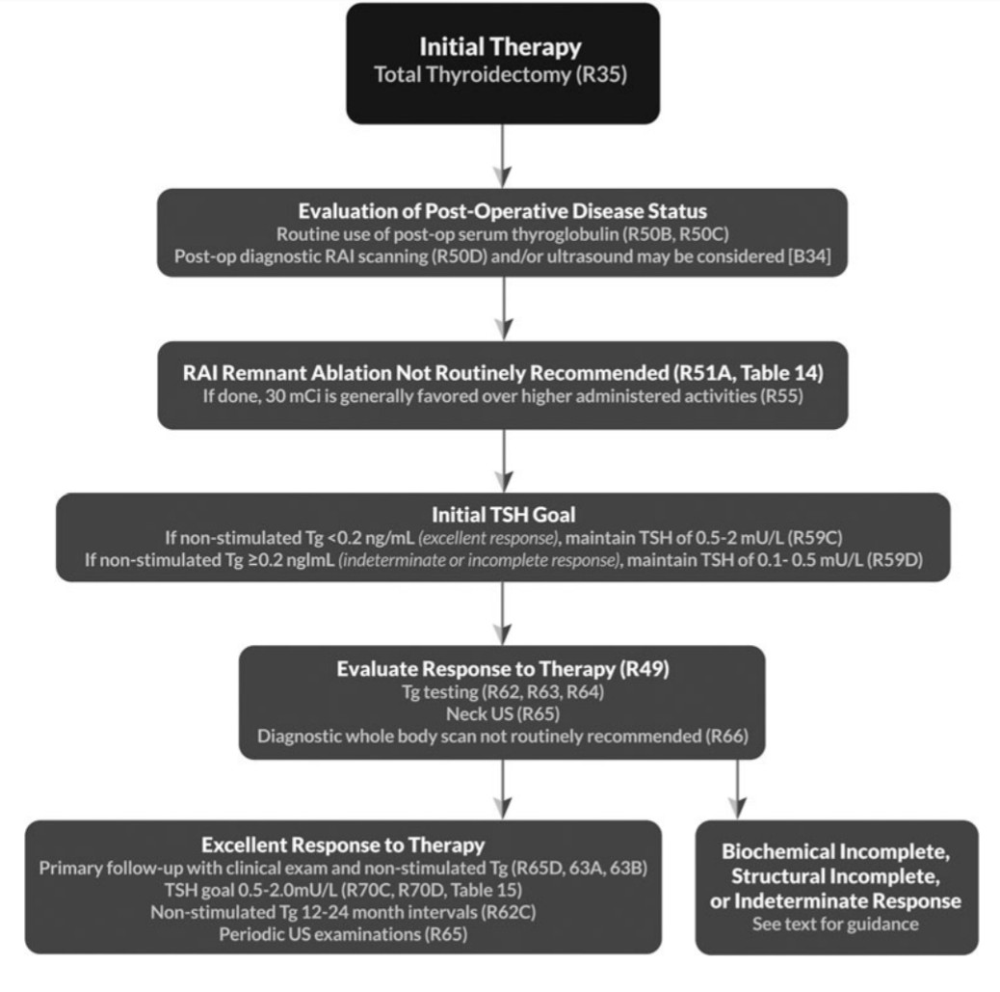
Overview of DTC management according to risk stratification systems
ATA low risk patients who have
undergone total thyroidectomy

Slide 34
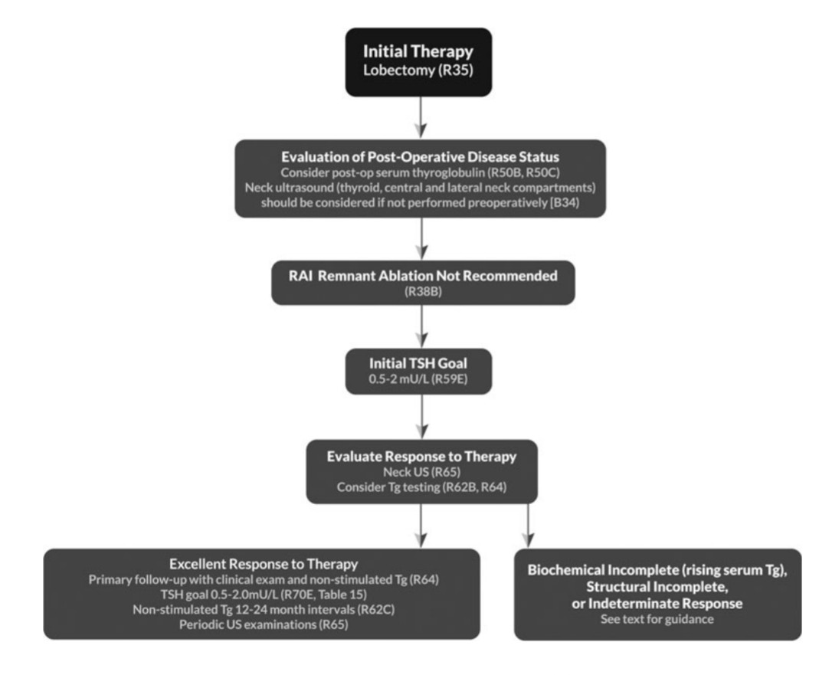
ATA low risk that have
undergone lobectomy

Slide 35
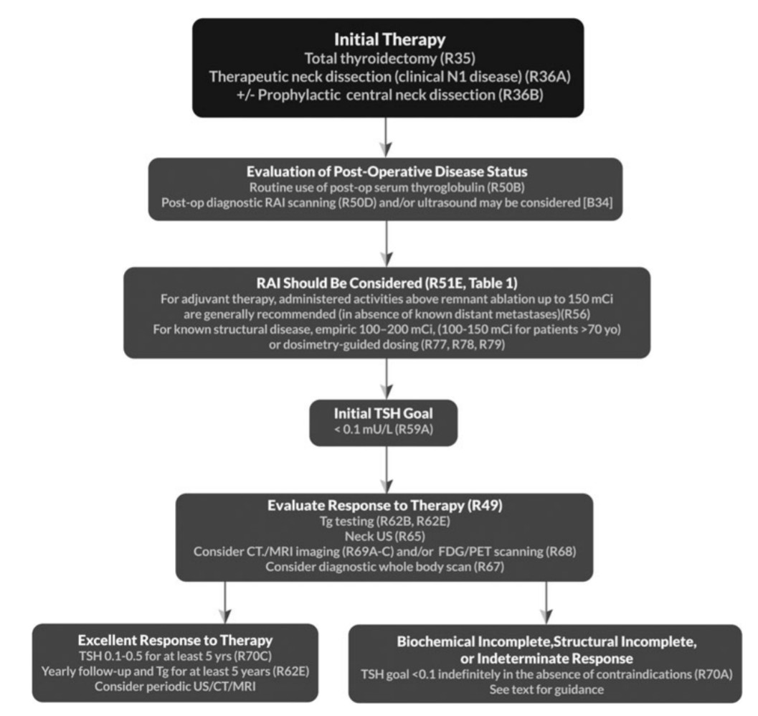
ATA intermediate risk

Slide 36
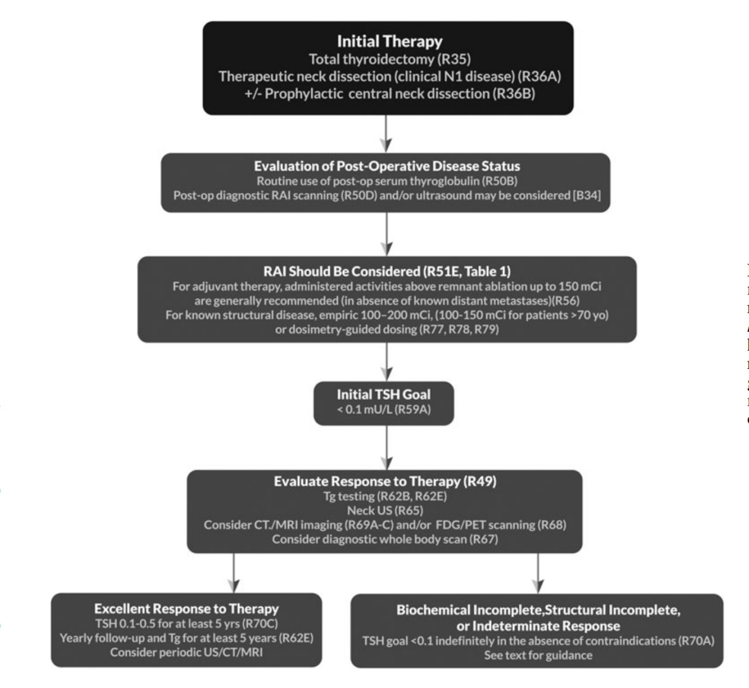
ATA high risk category

Slide 37
Post op RAI therapy
Not routinely recommended for
ATA low risk DTC patients after thyroidectomy
Unifocal papillary microcarcinoma after lobectomy or total thyroidectomy
Multifocal papillary microcarcinoma after thyroidectomy in absence of other adverse features.
Considered for
ATA intermediate risk DTC after total thyroidectomy
Recommended for
- ATA high risk DTC patients after total thyroidectomy

Slide 38
3-4 weeks prior to RAI therapy or diagnostic testing, LT4 should be withdrawn and LT3 may be substituted for the initial weeks, and LT3 should be withdrawn for atleast 2 weeks.
Goal TSH> 30 mIU/L
rhTSH can be used instead of withdrawing LT4 in ATA low- and intermediate-riskDTC without extensive nodal involvement. In ATA intermediate risk with extensive nodal involvement, rhTSH may be considered.

Slide 39
For ATA low- and intermediate risk patients after total thyroidectomy and no gross residual disease, dose of I-131 is 30mCi
For treating suspected microscopic residual disease, dose is 150mCi.
Post therapy whole body scan, with or without SPECT is recommended.

Slide 40
ATA risk category | TSH levels
High risk | <0.1
Intermediate risk | 0.1-0.5
Low risk + thyroidectomy + undetectable Tg | 0.5-2
Low risk + thyroidectomy + low level serum Tg | 0.1-0.5
Low risk + lobectomy | 0.5-2
No role of EBRT
No role of routine systemic adjuvant therapy

Slide 41
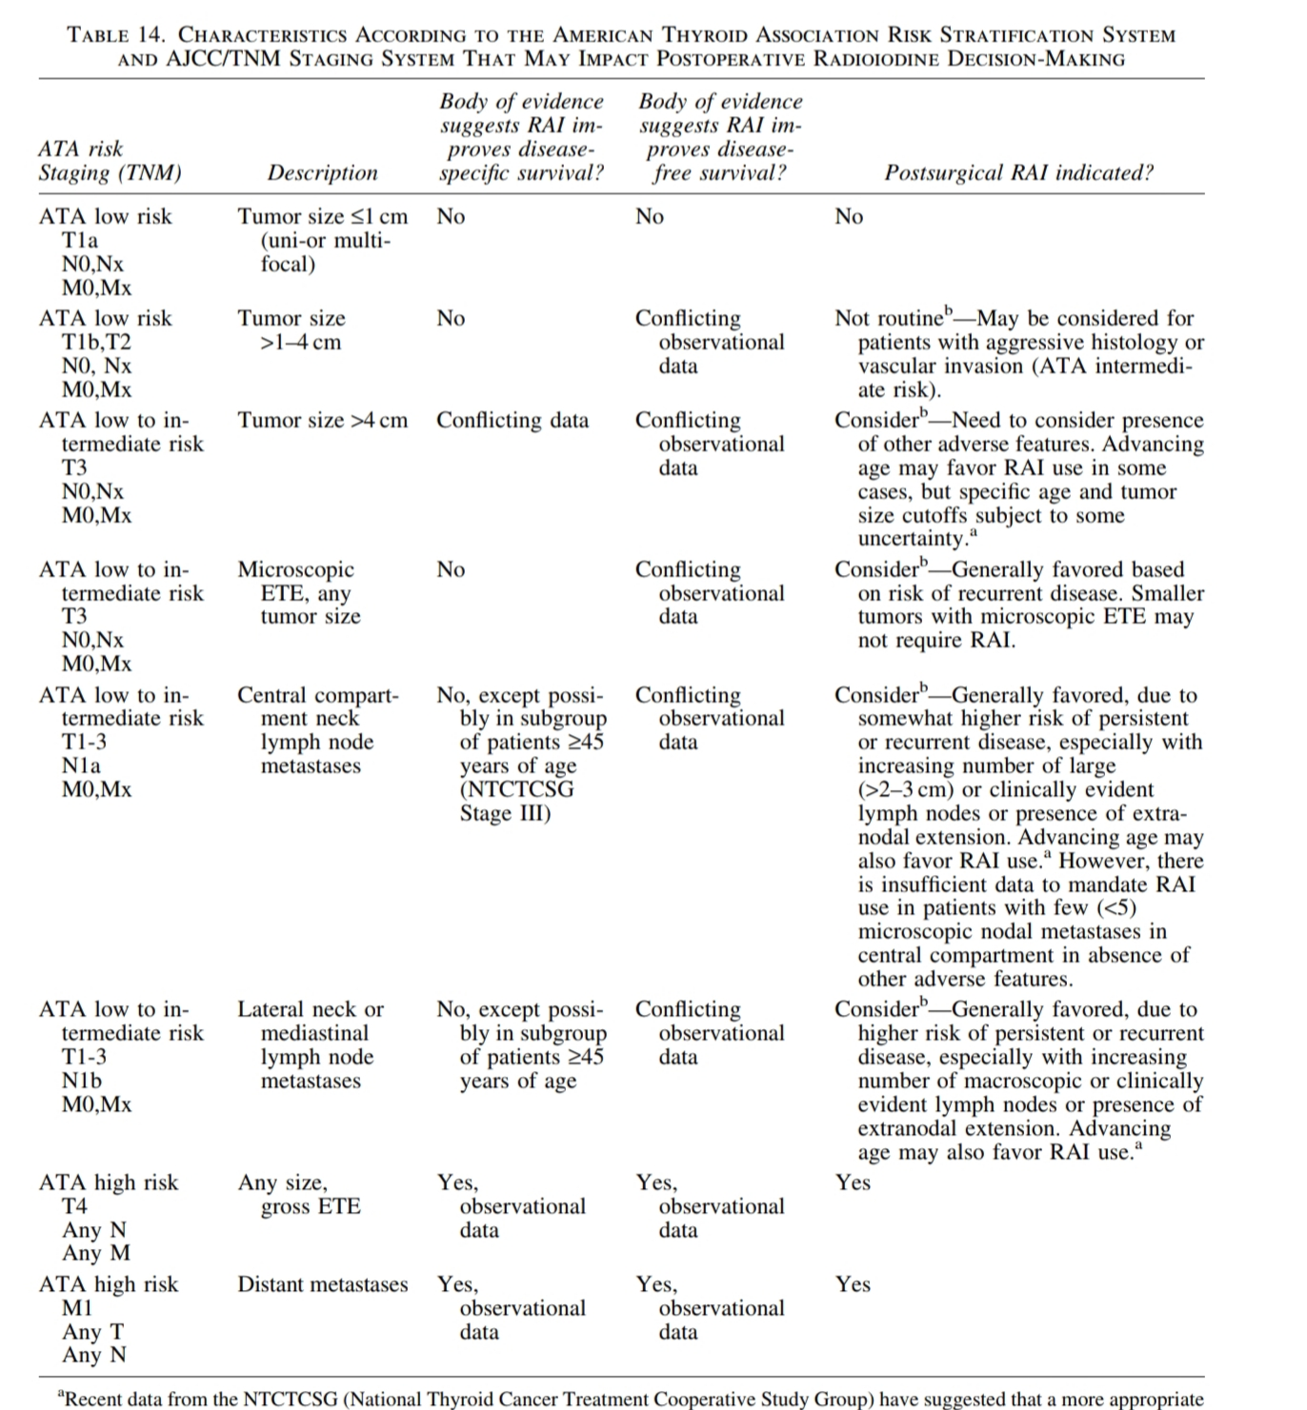
Summary of role of RAI

Slide 42
Follow up of DTC
Serum Tg every 6-12 months
Serum TSH every 12 months
Cervical USG every 6-12 months, SOS USG guided FNAC from suspicious lymph nodes >8-10 mm diameter
Diagnostic WBS 6-12 months after adjuvant RAI can be useful in the follow up of patients with high or intermediate risk of persistent disease, and should be done with I-123 or low activity I-131.
Dose for diagnostic WBS is 3-5 mCi.
FDG-PET should be considered in high risk DTC patients with elevated serum Tg (>10 ng/ml) with negative RAI.

Slide 43
Complications of RAI
Salivary gland damage
Dental caries
Nasolacrimal duct obstruction
Secondary malignancies-Risk of leukemia is increased. Risk of secondary malignancies is dose related to the order of 14.4 solid organ and 0.8 leukemias per 27 mCi of I-131 at 10,000 person years of follow up.
Patients should have baseline CBC and RFT.

