Slide 1
Testicular malignancies
- Dr Shivam Pandya

Slide 2
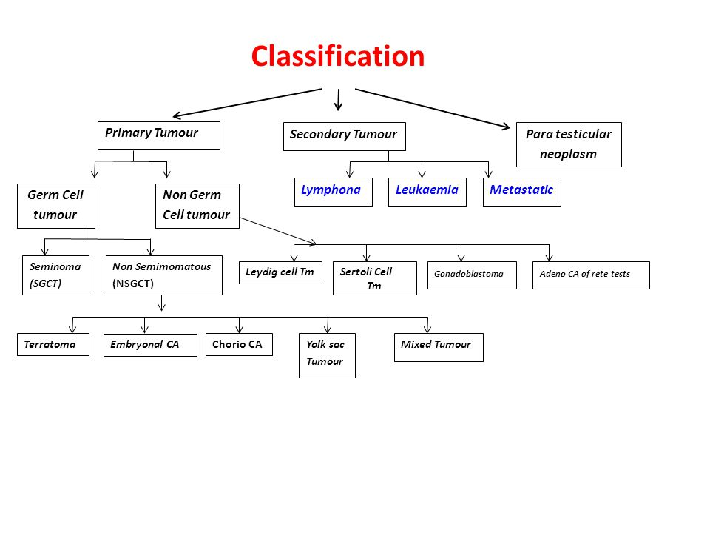
Classification

Slide 3
Risk factors
Family history- Increased risk if 1st degree relative involved
Cryptorchidism
Second primary in contralateral testis in survivors
Heavy cannabis use (Single Swedish study)

Slide 4
Intratubular Germ Cell Neoplasm
Origin point of all testicular germ cell tumors except Spermatocytic seminoma.
Newer nomenclature- Germ Cell Neoplasia In Situ (GCNIS)
It is seen as an incidental finding of microlithiasis on testicular USG
5 year risk of contralateral ca testis in men with unilateral GCT and C/L GCNIS- 50%

Slide 5
Clinical features
Most common feature is testicular swelling
Heaviness, testicular pain
Sometimes, primary tumors are “burnt out” and the only symptoms are due to mets, such as back ache, dyspnea, cough, hemoptysis

Slide 6
hCG- borderline rise
PLAP +
CK+/-
CD30, AFP, EMA -ve
Seminoma
CK +
CD30 +
PLAP +
AFP +
hCG +
Embryonal carcinoma
Embryonal carcinoma is most undifferentiated.
LDH is important prognostic factor in metastatic Embryonal cancer that is marker -ve

Slide 7
hCG+
Hematogenous mets
Tumor hemorrhage common
Choriocarcinoma
Schiller-Duval bodies
Marker- AFP++
IHC- AFP, CK, SALL4, Glipican 3, PLAP, CD117 +ve
Yolk sac tumor

Slide 8
-Somatic cells from two germ cell layers, usually a component of adult mixed NSGCT
-Classified as immature and mature teratoma.
-Can give rise to secondary somatic malignancies such as RMS, PNET, poorly differentiated carcinoma
Teratoma

Slide 9
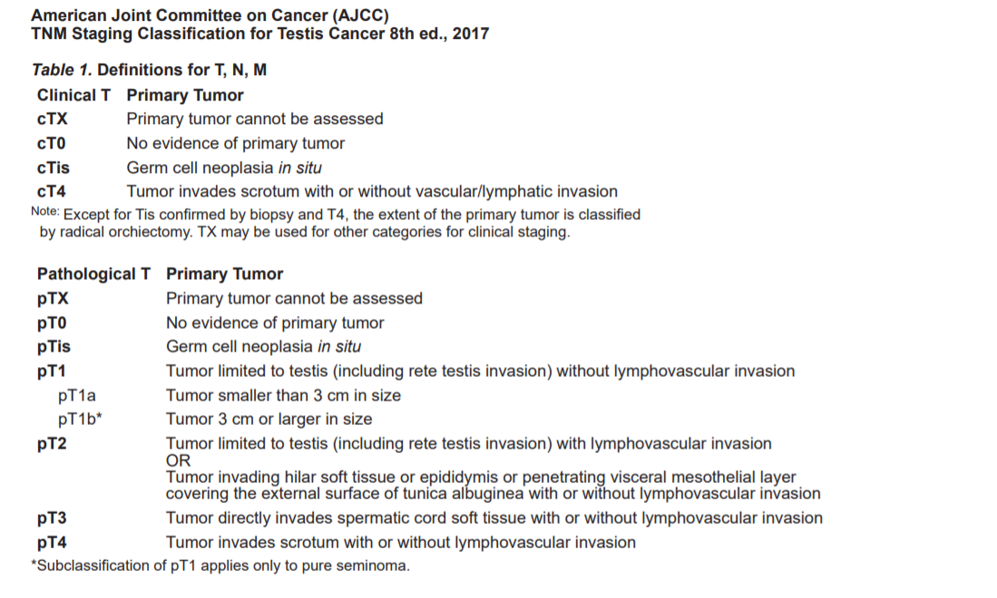
Staging

Slide 10
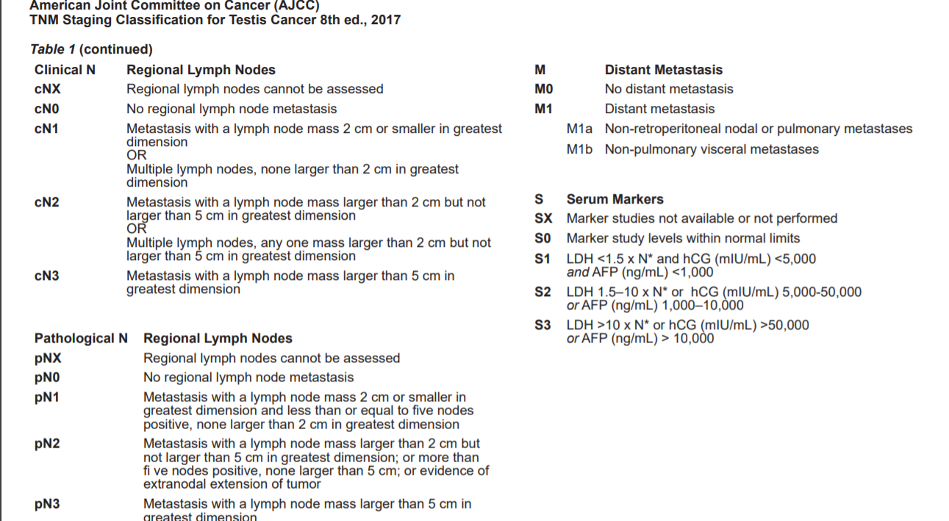
Staging (contd)

Slide 11
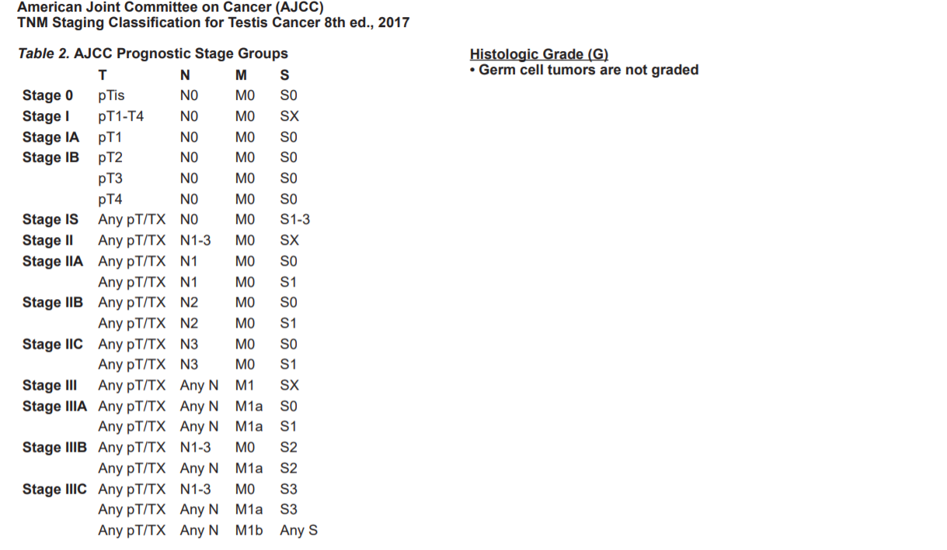
Staging (contd)

Slide 12
Markers
3 main markers- AFP, hCG, LDH
Markers elevated prior to orchidectomy and normalize after orchidectomy have no prognostic value
Markers that do not normalize after orchidectomy, but there is no e/o metastatic disease-→ Stage 1s
LDH is a prognostic factor in NSGCT prior to chemo, but no prognostic importance in seminoma

Slide 13
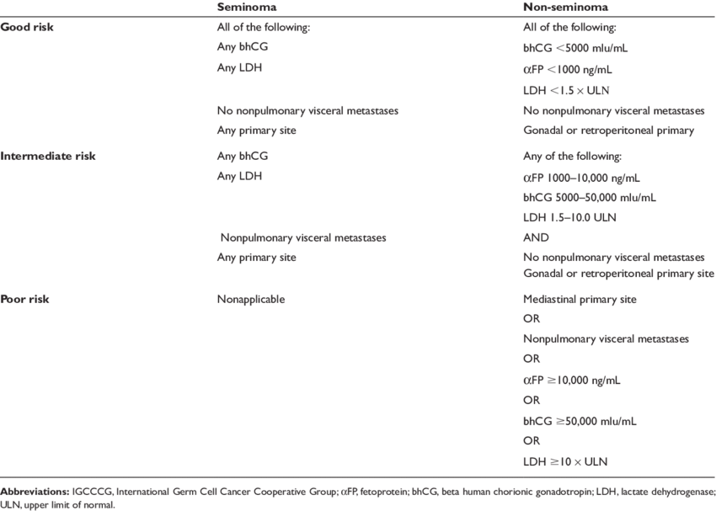
Factors affecting outcome
International Germ Cell Cancer Cooperative Group classification for metastatic GCT

Slide 14
Prognostic classifications for relapsed/refractory disease
beta-hCg >1000
Primary mediastinal NSGCT
Platinum refractory disease
Progressive disease immediately before receiving High dose Chemo (HDCT)
Beyer Score
Classified as low, intermediate and high risk
Primary site
Prior response to treatment
Progression free survival
AFP, beta-hCG level
-Histology
Site of disease
International prognostic factors Study (IPFS)
Classified as very low, low, intermediate, high and very high risk

Slide 15
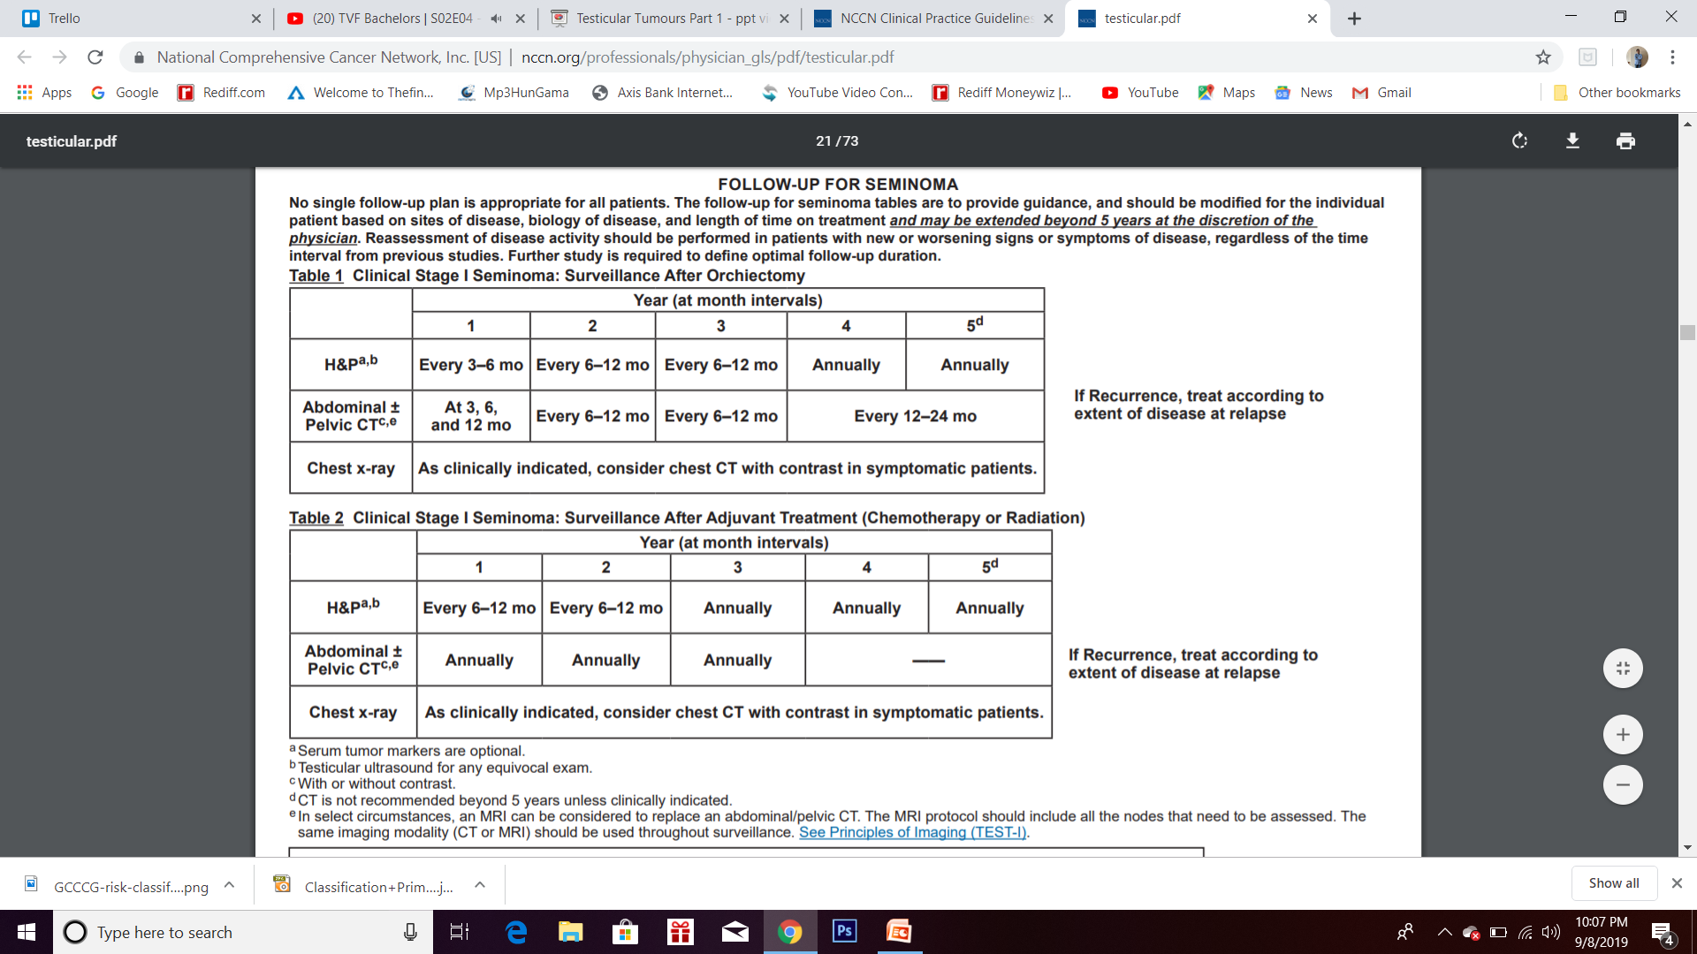
Stage 1 disease
Seminoma- Can be classified into average and high risk (>4cm, rete testis involvement). But, management for both groups is same.
Management options- 1) Observation
2) Adjuvant chemo- Carboplatin 1 or 2 courses
3) Prophylactic RT to para-aortic lymph node (but it has increased risk of midline cancers)

Slide 16
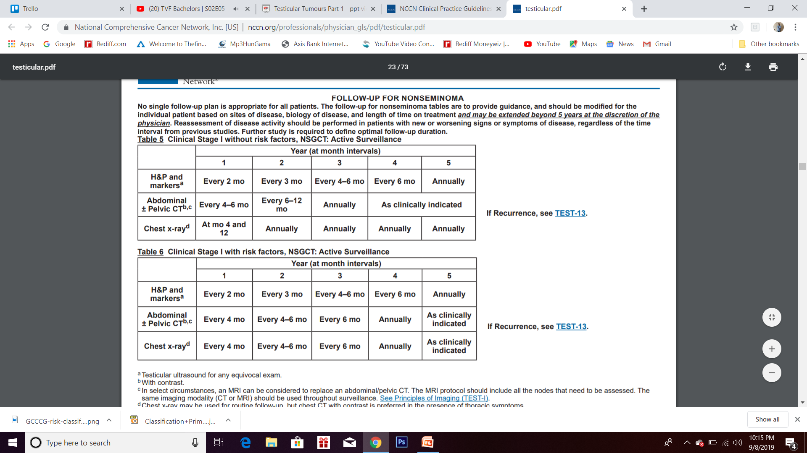
Stage 1 (NSGCT)
Stage 1A- Standard of care is observation. Pt should agree for follow up SOS chemo by cisplatin.
Nerve sparing RPLND, if patient might not be compliant. However it is useless for embryonal carcinoma, since it spreads by hematogenous route
Stage 1B- Adjuvant chemo with Bleomycin + Etoposide + Cisplatin (BEP) regime 1 or 2 courses.
RPLND done to stage accurately in stage 1. It is curative for teratoma.

Slide 17
Stage 2 (Low tumor burden)
Low tumor burden- Metastasis confined to retroperitoneal nodes + S0/S1 for NSGCT
Seminoma
<3 cm
RT to retroperitoneum + boost to nodes (dog leg field)
>3 cm
Cisplatin based chemo f/b RT
NSGCT
Stage 1s
BEP x 3cycles or EP x 4 cycles. Active surveillance can be considered
Stage 2 after RPLND
<6 LN, <2 cm in max dimension, no ENE (pN1)
N2
N3
Surveillance or BEP/EP x 2 cycles
BEP x2 cycles
BEP x 3 cycles or EP x 4 cycles

Slide 18
Enlarged lymph node + S1 -→ BEP x 3 cycles
N1 + S0 --→ Nerve sparing bilateral RPLND or Chemotherapy
Chemo preferred if:
- Markers raised
Back pain
>2 cm
Embryonal carcinoma

Slide 19
Stage II (High tumor burden) + Stage 3
Stage II (high tumor burden) + Stage III
Good prognosis
BEP x 3 cycle +/- surgery or EP x 4 cycles
Intermediate and poor prognosis
Seminoma
VIP (Ifosfamide + Etoposide + Cisplatin)
NSGCT
BEP x 4 cycles or VIP if risk of pulm toxicity is high

Slide 20
Residual mass
<1 cm (NSGCT)
Observation > RPLND
>1 cm (NSGCT)
B/L RPLND
Seminoma
< 3cm
>3 cm
More likely to be fibrotic scar- observation
RT/RPLND if PET +ve

Slide 21
Recurrent disease
Conventional dose chemo-
1) Vinblastin + Ifosfamide + Cisplatin – 4 cycles
2) Paclitaxel + Ifosfamide + Cisplatin (TIP)- 4 cycles
High dose chemo + Autologous SCT- High dose carboplatin + Etoposide (tandem transplant)
MSKCC trial- 1-2 cycles of paclitaxel + ifosfamide f/b 3 cycles of high dose Carboplatin + etoposide

Slide 22
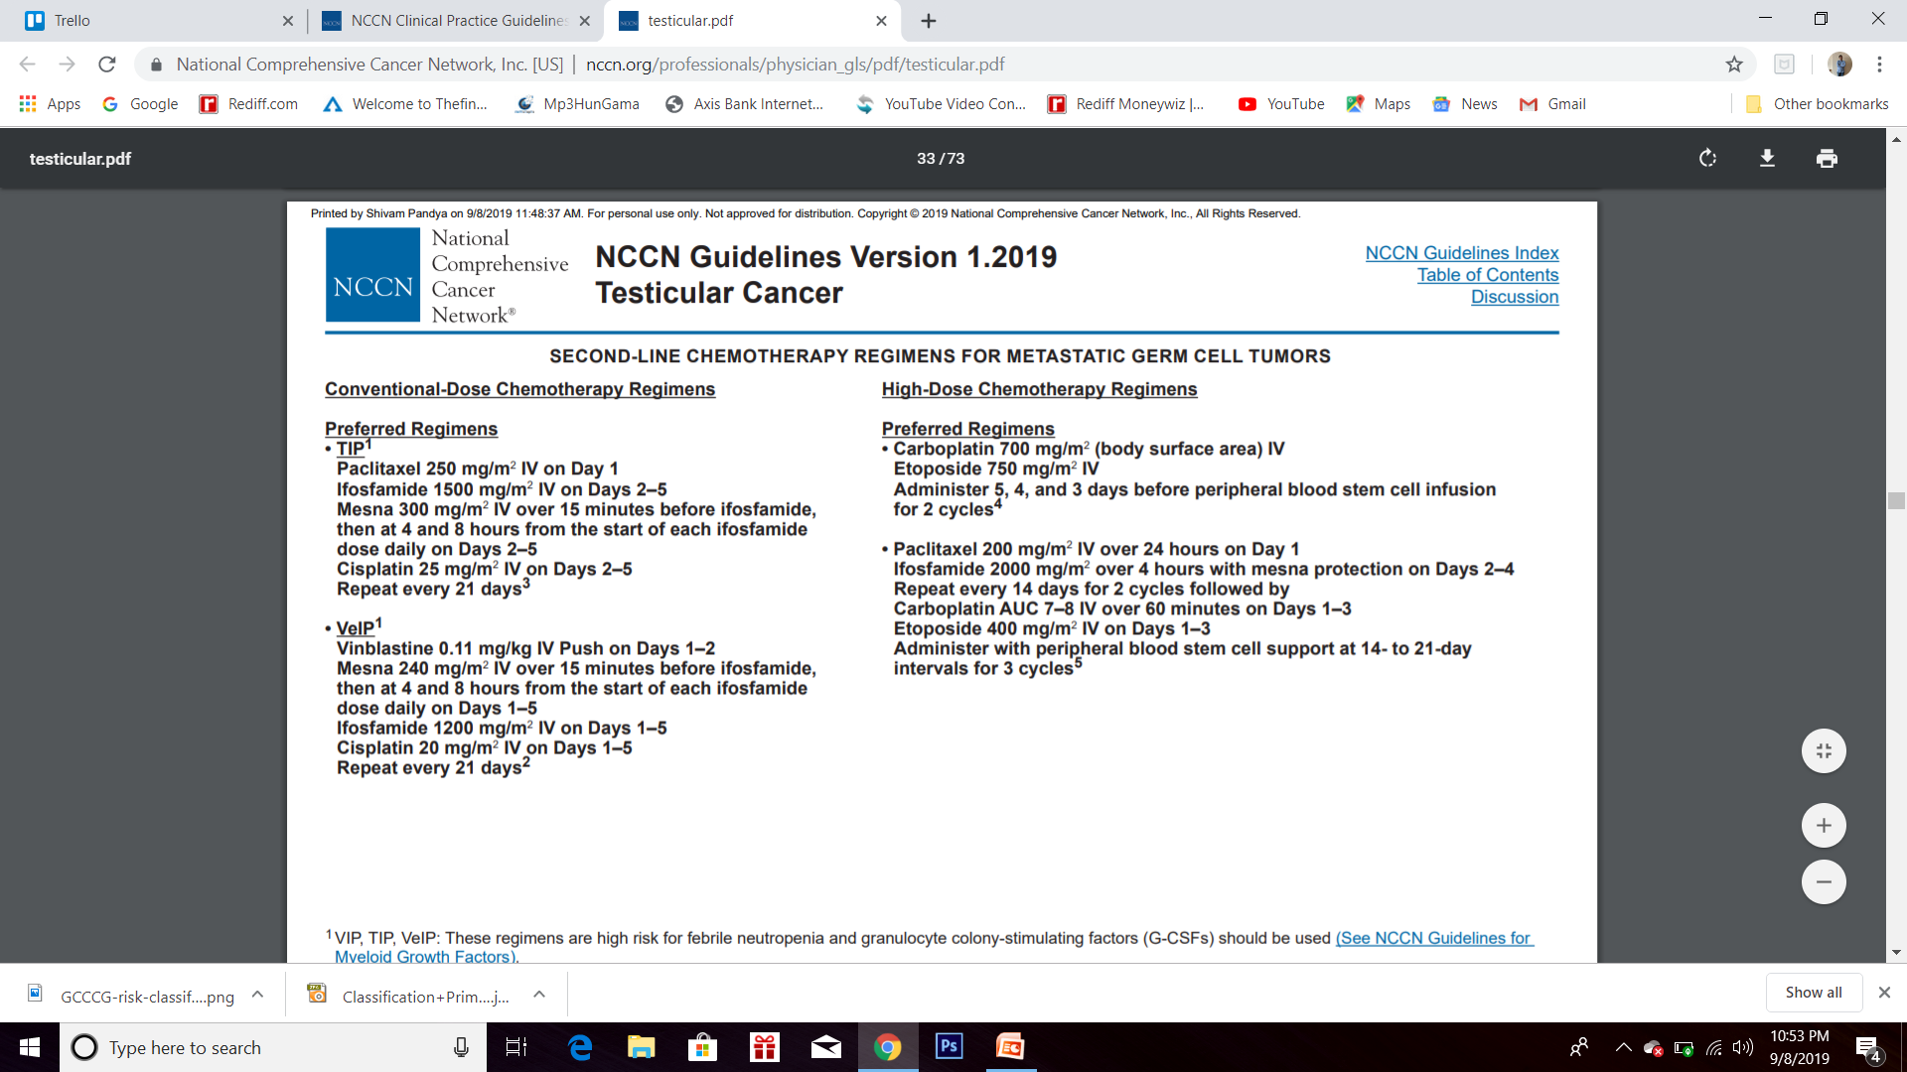
Recurrent disease (contd)

Slide 23
Second and subsequent relapse
Conventional chemo
Gemcitabine + Oxaliplatin
Gemcitabine + Paclitaxel
Gemcitabine + Oxaliplatin + Paclitaxel + Oral etoposide
Salvage surgery is successful in 20 % patients. It is more successful in patients with raised AFP and normal hCG than patients with raised hCG.

Slide 24
Other histologies of testicular cancers
Sex cord tumors
Leydig cell tumor- Cause decreased libido, gynecomastia
Sertoli cell tumor- Precocious puberty
Granulosa cell tumor
Estrogenic tumor
Treatment is surgery only
Treatment- radical orchidectomy. Mixed results with Mitotane.
CT/RT not effective
Mesothelioma of tunica vaginalis
Treatment- Radical orchidectomy + excision of spermatic cord and hemiscrotum
RPLND is done if LVI/ testicular parenchyma invasion seen
Lymphoma
Most common testicular malignancy after age of 50 years

Slide 25
Thank you!

